Slide 1
L17: DataVis Libraries

Slide 2
Today’s Outline
Part 1: Integrating Data with Leaflet: An Exercise
Part 2: Data visualization
Visual encodings
Pyramid of web visualization libraries
D3.js demo

Slide 3
Part 1: Warm-Up Activity
Visualize yelp reviews:
Open the leaflet folder
Query for yelp data
Make some markers to display Yelp location
If time: vary the size depending on the # of reviews

Slide 4
Part 2: Information Visualization

Slide 5
10,000 Foot View
People are good at making sense of quantitative and categorical data visually
It’s important to visually encode data in a principled way to assist with interpretability (I’ve linked to a few articles that discuss this).
There are many different visualization techniques (which are ever-growing)
There are also many different JavaScript-based visualization libraries
If this interests you, you should take an InfoVis class!

Slide 6
Data Types
Quantitative Is the thing something you can objectively measure with numbers? Types of quantitative data
Continuous (e.g. age, weight, temperature)
Discrete (e.g. # of cars per household; # of votes per candidate)
Qualitative A qualitative dimension or grouping
Categorical (e.g. car’s make, model, and color)
Binary (yes/no, e.g. “is vaccinated,” “has a HS diploma”)
Ordinal (e.g. strongly disagree to strongly agree; 5 stars on Yelp!)

Slide 7
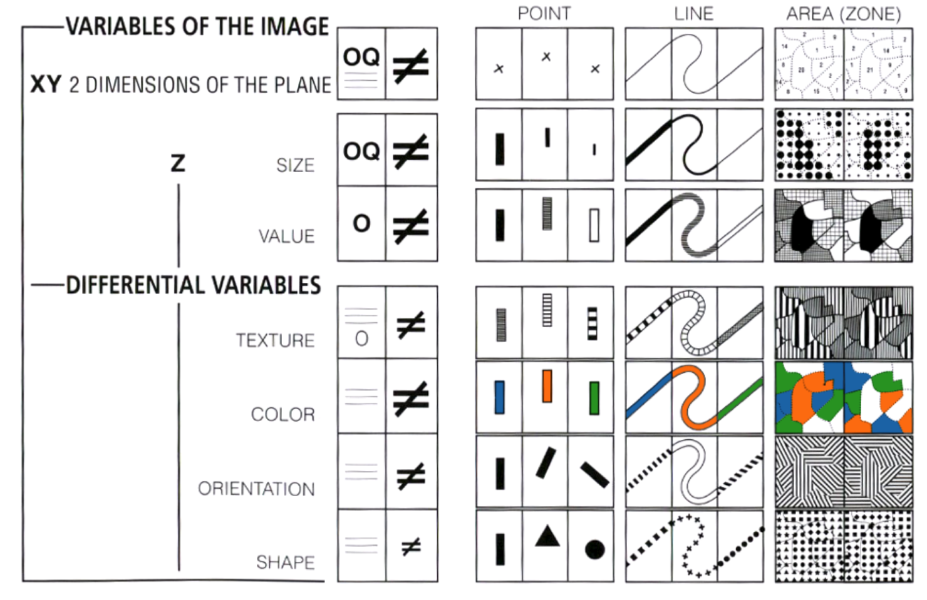
Visually Encoding Data Through “Retinal Variables”
https://graphworkflow.com/retinal/

Slide 8
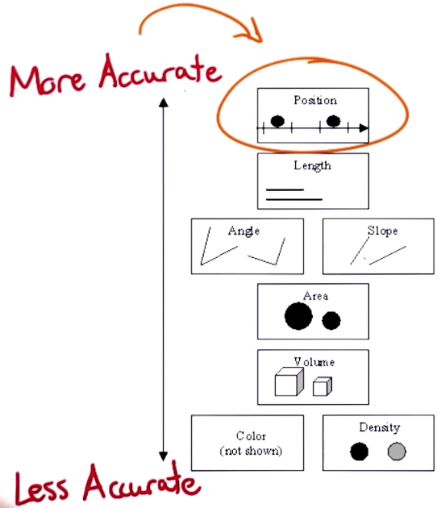
Which Visual Encodings are easier for people to interpret?
Position along a common scale (bar chart, dot plots)
Positions along nonaligned, identical scales (small multiples)
Length, direction, angle (pie chart)
Area (treemap)
Volume, curvature (3-D bar charts, area charts)
Shading, color saturation (heat maps, choropleth maps)
Source

Slide 9
The “Visualization Zoo”
Heer, J., Bostock, M., & Ogievetsky, V. (2010). A tour through the visualization zoo. Communications of the ACM, 53(6), 59-67. https://queue.acm.org/detail.cfm?id=1805128
Nice overview of which visualizations to use for which contexts.

Slide 10
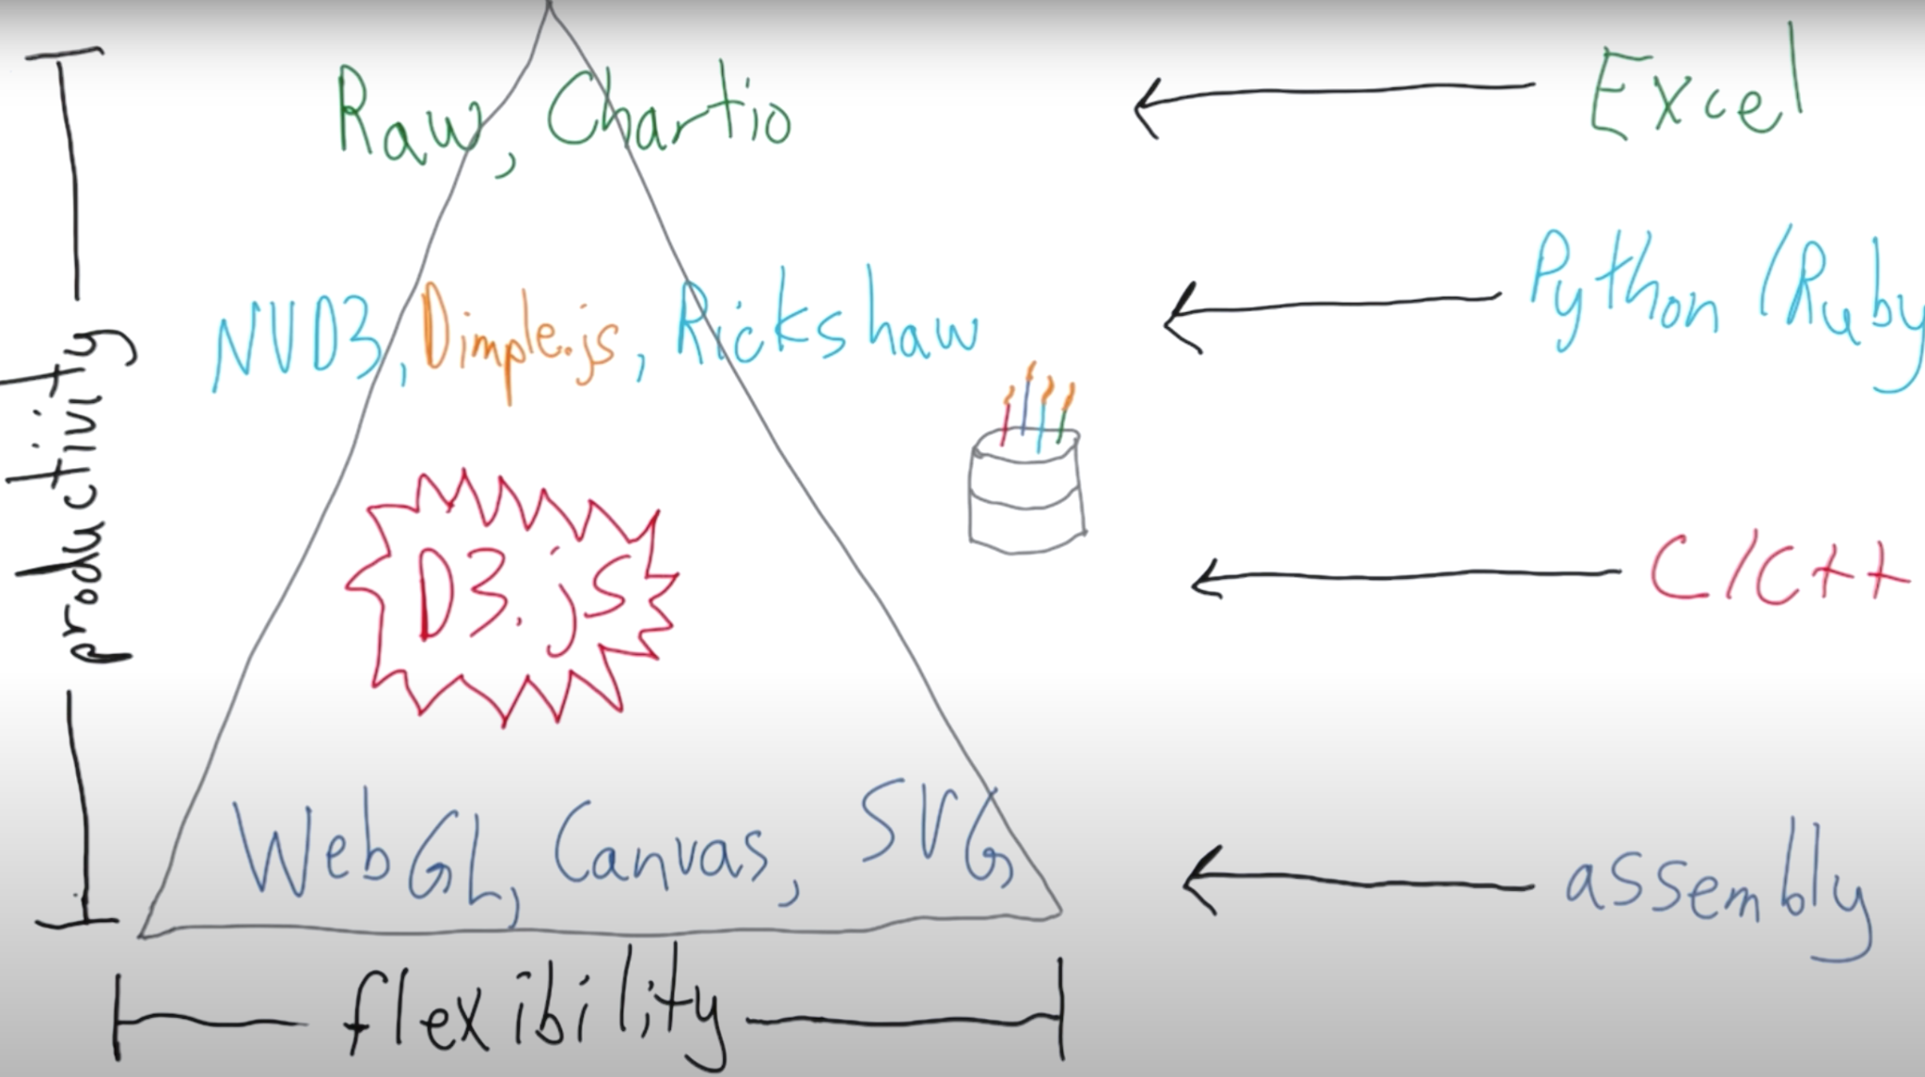
“Pyramid” of DataVis Technologies
Data Vis tools vary in terms of their level of abstraction...
https://www.youtube.com/watch?v=NdVf2bY8OnM

Slide 11
Demos
(lecture files)

